Slide 1
Sample Lecture Note
Priority Queue: The Binary Heap
Priority Queue
Heap
Heap Sort

Slide 2
Remember the concept of QUEUE:
A queue can hold an arbitrary number of elements, but you add new elements at one end (rear) and remove elements from the other end (front).
front
rear
Sometimes called a FIFO structure, for
First In, First Out.

Slide 3
Queue (continued)
In queue data is ordered based on their arrival time.
In queue the order of elements does not change while they are waiting in the queue.

Slide 4
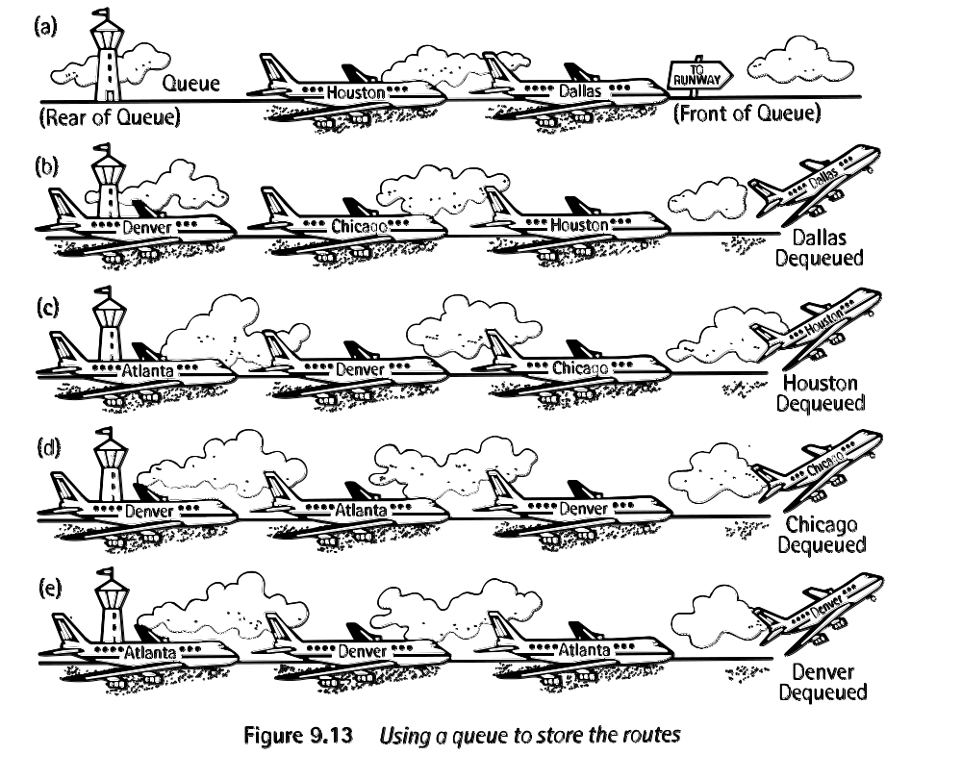
Real Life Queues

Slide 5
Definition of Priority Queue
Actually, not like the regular queue at all. Instead, permits the removal of the element with highest priority (smallest / largest element) contained in the collection.
Priority queue can be represented by a simple linked list.
Two ways to implement:
Insert at beginning constant time
find the minimum and delete linear time
Keep the list sorted.
Insert in proper place linear time
Delete the first element constant time

Slide 6
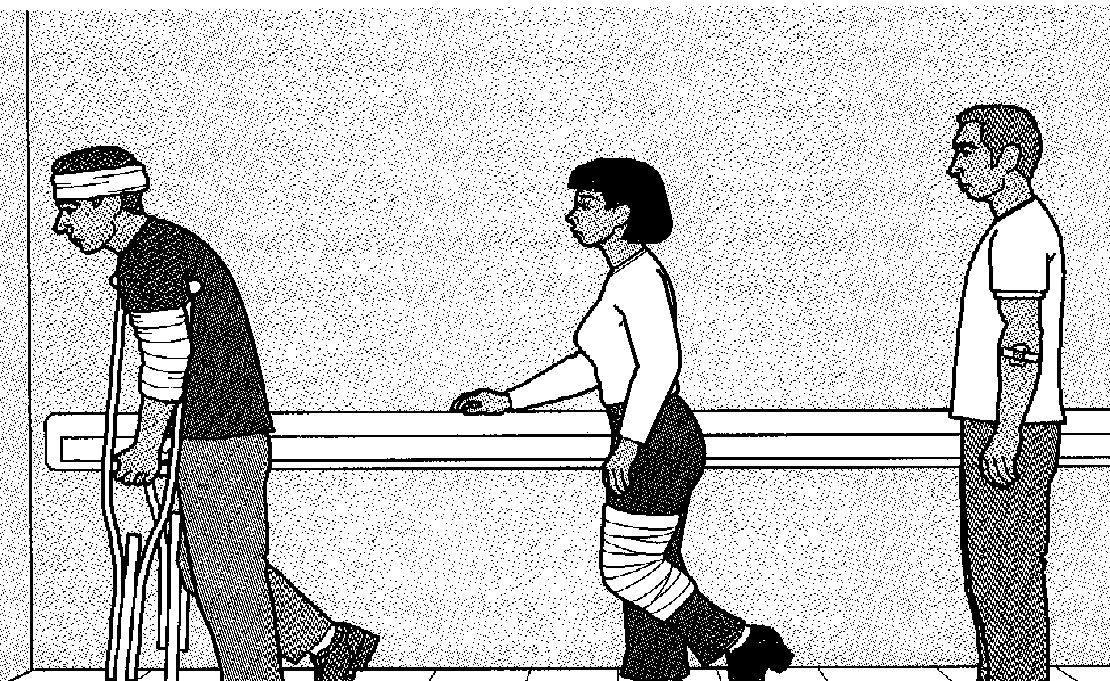
A Real Life Priority Queue

Slide 7
Complete binary tree
Remember: A complete binary tree is a binary tree which is completely filled, with the exception that the bottom level may not be filled and the nodes at the bottom level are filled from left to right.
10
3
8
11
2
7
5
14
12
9
16

Slide 8
Heap
Heap is a complete binary tree with the following heap property:
In a heap, for every node X with parent P, the key in P is smaller (larger) or equal to the key in X.
P
P
P <= X
P >= X
Min Heap
Max Heap
X
X

Slide 9
Definitions of Min Heap and Max Heap
A minimum heap is a complete binary tree with the property that each node is smaller than (or equal to) all nodes in either left or right subtree.
A maximum heap is a complete binary tree with the property that each node is larger than (or equal to) all nodes in either left or right subtree.

Slide 10
2
3
5
9
10
7
8
14
12
11
16
minimum heap
45
36
42
26
34
28
30
15
23
22
10
maximum heap

Slide 11
Array Representation of Heap
When array representation is applied to a min heap, the smallest element is always held in the first location of array.
0
1
2
3
4
5
6
7
8
9
2
3
5
9
10
7
8
14
12
11
This is a zero base array
2
If a node is at location k, its left child is at location 2k+1 and its right child is at location 2k+2 if they exist. Its parent is at (k-1)/2 if it has one.
3
5
9
10
7
8
14
12
11

Slide 12
Question
What about if the array is one base?
Do the same formulas work in this case too?
If not, how do the formulas change for this case?

Slide 13
Array Representation of Heap continued
2
3
4
1
5
6
7
8
9
10
2
3
5
9
10
7
8
14
12
11
This is a one base array
If a node is at location k, its left child is at location 2k and its right child is at location 2k+1 if they exist. Its parent is at k/2 if it has one.
2
3
5
9
10
7
8
14
12
11

Slide 14
Adding an Element
To add a new element, put it at the end of the array. But then the heap property may be destroyed. To restore the heap property, move elements down until the new value finds it's proper location.

Slide 15
Adding an Element
2
3
5
9
10
7
8
14
12
11
16
position
Insert a 4. It would be at the end of the
active array.

Slide 16
Adding an Element
2
3
5
parent
9
10
7
8
14
12
11
16
position
If the number to be inserted is less than
the parent (position/2) then move the
element in (position/2) to this position.

Slide 17
Adding an Element
2
parent
3
5
9
10
8
14
12
11
16
7
position
If the number to be inserted is less than
the parent (position/2) then move the
element in (position/2) to position.

Slide 18
Adding an Element
parent
position
2
3
9
10
5
8
14
12
11
16
7
If the number to be inserted is greater than
or equal to the parent, you found the location
to insert the new element.

Slide 19
Adding an Element
parent
position
2
3
4
9
10
5
8
14
12
11
16
7
If the number to be inserted is greater than
or equal to the parent, you found the location
to insert the new element.

Slide 20
Removal
Removing the smallest element is easy. What is hard is making it back into a complete binary tree.
Solution: move the last element (bottom rightmost) into the tree at the right location. Again, take the "hole" at the top and move it around until you find where the new element should go.

Slide 21
Remove the minimum value, leaving a hole.
2
3
4
9
10
5
8
14
12
11
16
7

Slide 22
Remove the minimum value, leaving a hole.
2
3
4
9
10
5
8
14
12
11
16
7
3
4
9
10
5
8
14
12
11
16
7

Slide 23
3
4
9
10
5
8
14
12
11
16
7

Slide 24
3
4
9
10
5
8
14
12
11
16
7
Fill the hole with the last element in the heap
7
3
4
9
10
5
8
14
12
11
16

Slide 25
7
3
4
9
10
5
8
14
12
11
16
Find the right place for the new element by exchanging it with it's smallest child until both children are bigger

Slide 26
7
3
4
9
10
5
8
14
12
11
16
Find the right place for the new element by exchanging it with it's smallest child until both children are bigger
3
7
4
9
10
5
8
14
12
11
16
At this point we terminate with A heap.

Slide 27
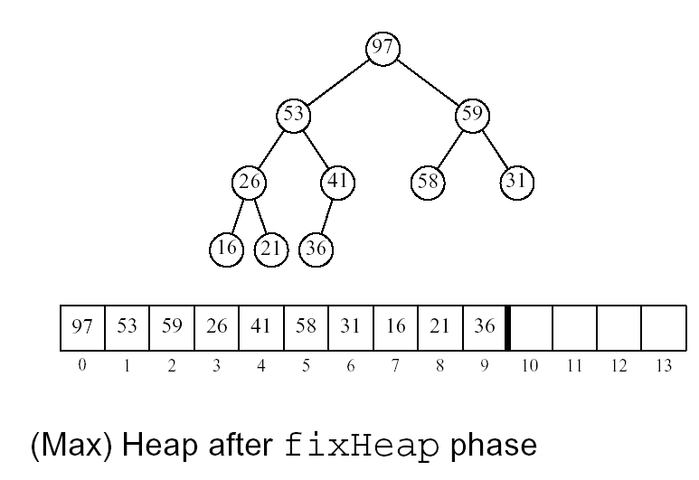
Application - Heap Sort

Slide 28
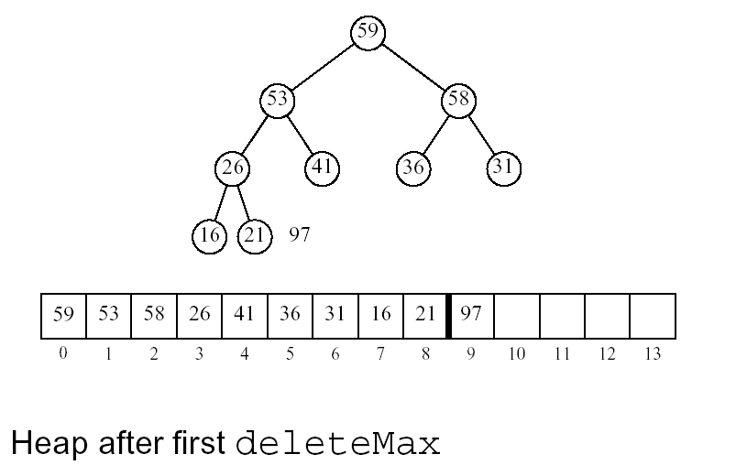
Heap Sort (continued)

Slide 29
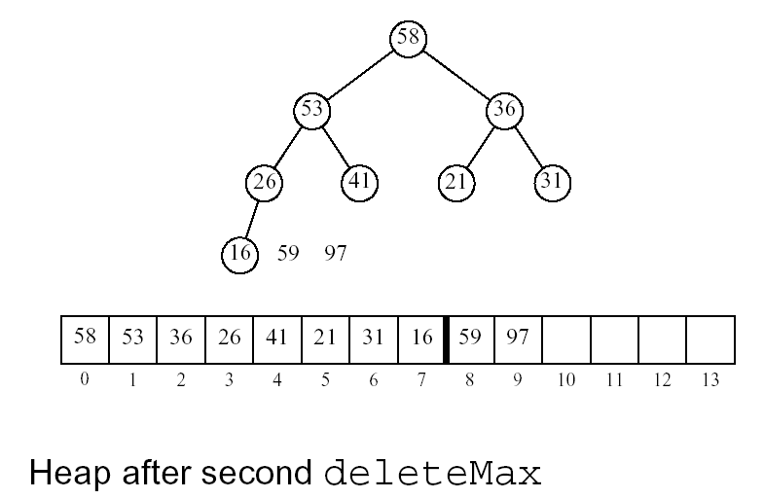
Heap Sort (continued)

Slide 30
Advantages of Heap Sort
Surprisingly fast O(n log n)
Does not require any additional structures (above and beyond the input/output vector).

Slide 31
    template <class Record>
    void Sortable_list<Record>::heap_sort()
    {
    Record current;
    int last_unsorted;
    build_heap();.
    for (last_unsorted = count - 1; last_unsorted > 0;
    last_unsorted--)
    {
    current = entry[last_unsorted];
    entry[last_unsorted] = entry[0];
    insert_heap(current, 0, last_unsorted - 1);
    }
    }
This function will take the largest element from 0 position and put it at the end and then calls insert to rebuild the heap

Slide 32
    template <class Record>
    void Sortable_list<Record>::
    insert_heap(const Record &current, int low, int high)
    {
    int large;
    large = 2 * low + 1;
    while (large <= high) {
    if (large < high && entry[large] < entry[large + 1])
    large++;
    if (current >= entry[large])
    break;
    else {
    entry[low] = entry[large];
    low = large;
    large = 2 * low + 1;
    }
    }
    entry[low] = current;
    }
This function will move the hole down as far as it is needed and then puts current in there

Slide 33
    template <class Record>
    void Sortable_list<Record>::build_heap()
    {
    int low;
    for (low = count / 2 - 1; low >= 0; low--) {
    Record current = entry[low];
    insert_heap(current, low, count - 1);
    }
    }

Slide 34
Comparison of Sorts
Selection
O(n²)
Insertion
O(n²)
Heap
O(nlog n)
Quick
O(nlog n)
Merge
O(nlog n)
Radix
O(nk)
Shell is in the range of n^{1.25} to 1.6n^{1.25}
n is large. An improvement over insertion sort.

Slide 35
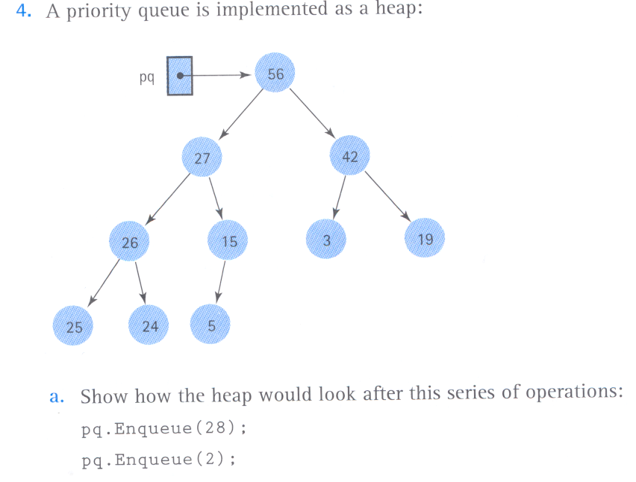
Exercise 1

Slide 36
Exercise 2
A priority queue containing characters is implemented as a heap stored in an array. The precondition states that this priority queue can not contain duplicate elements. Currently, the priority queue holds 10 elements, as shown bellow:
What values might be stored in array positions 7-9 so that the properties of a heap are not violated? This is a max heap.
Z
F
J
E
B
G
H
?
?
?
0 1 2 3 4 5 6 7 8 9

Slide 37
The answer is A, C and D.

Slide 38

Priority Queue Sinks Into the Sea

